Slide 1


Slide 2


Porting Source 2 to Vulkan
Dan Ginsburg
Valve
Notes:
What I hope you get out of this talk is some useful information for porting your own engine to Vulkan.

Slide 3
Summary
Source 2 Overview
Porting to Vulkan
  Shaders and Pipelines
  Command Buffers
  Memory Management
  Descriptor Sets

Slide 4
Source 2 Overview

Slide 5
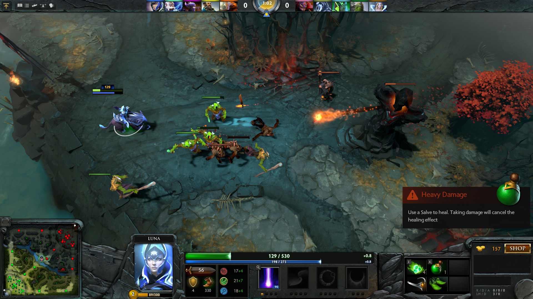
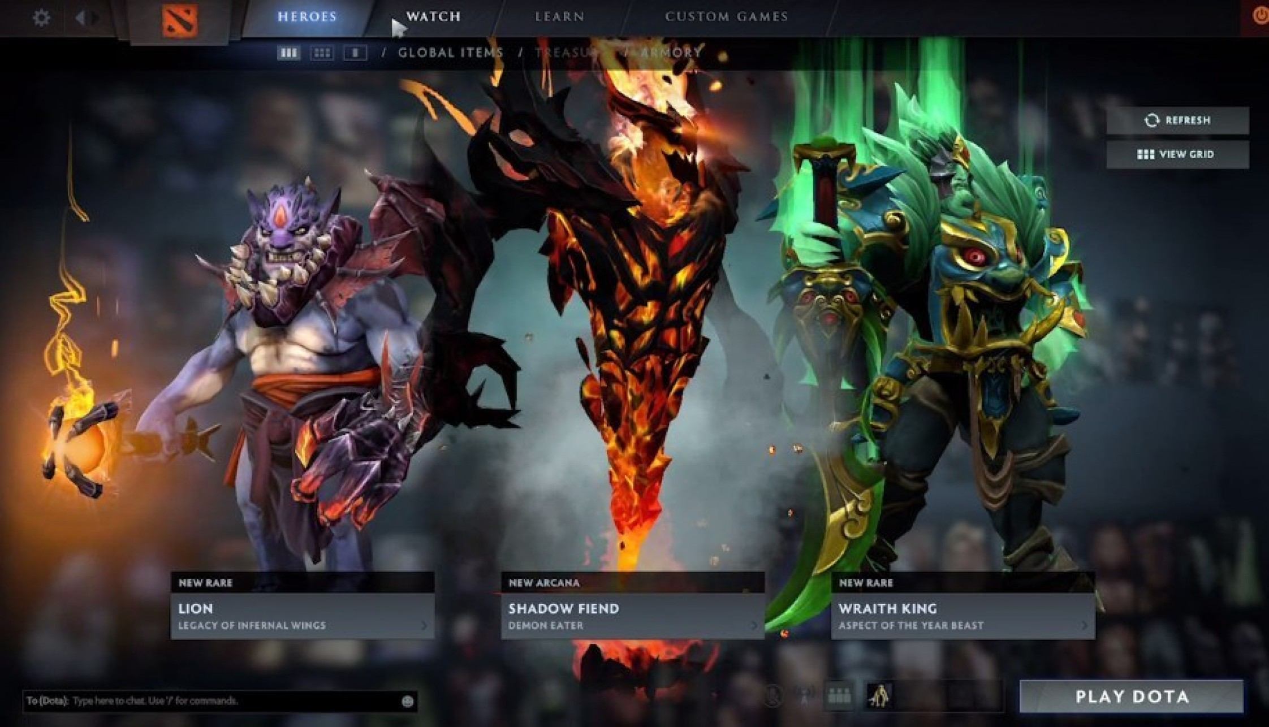
Source 2
OpenGL, DX9, DX11, Vulkan
Windows, Linux, Mac
Dota 2 Reborn

Slide 6
Source 2 Rendering
DX11-like rendersystem abstraction
Multithreaded
  DX9/GL: software command buffers
  DX11: deferred contexts
  Single submission thread

Slide 7
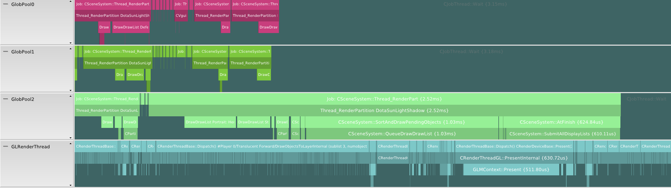
Source 2 Rendering (GL)

Slide 8
Source 2 Vulkan Port
Started with GL and DX11 renderer
  DX11 deferred contexts mapped well to Vulkan command buffers
  Leveraged GLSL shader conversion

Slide 9
Shaders and Pipelines

Slide 10
Porting Shaders to Vulkan
HLSL -> GLSL
  See: Moving Your Games to OpenGL, Steam Dev Days 2014
GLSL -> SPIR-V
  Descriptor set layout qualifiers to GLSL
  Open source glslang SPIR-V backend
  SPVremapper for compression
  https://github.com/KhronosGroup/glslang

Slide 11
Pipeline State Objects (PSOs)
  Each thread caches pipeline state
Global pipeline manager
  PSO Map
  Pending and current
    Reduces mutexing
Pipeline State Hash
Create PSO
PSO3
Lookup
Lookup
Current PSO Map
Pending PSO Map
PSO0
End of Frame
PSO1
PSO2

Slide 12
Command Buffers

Slide 13
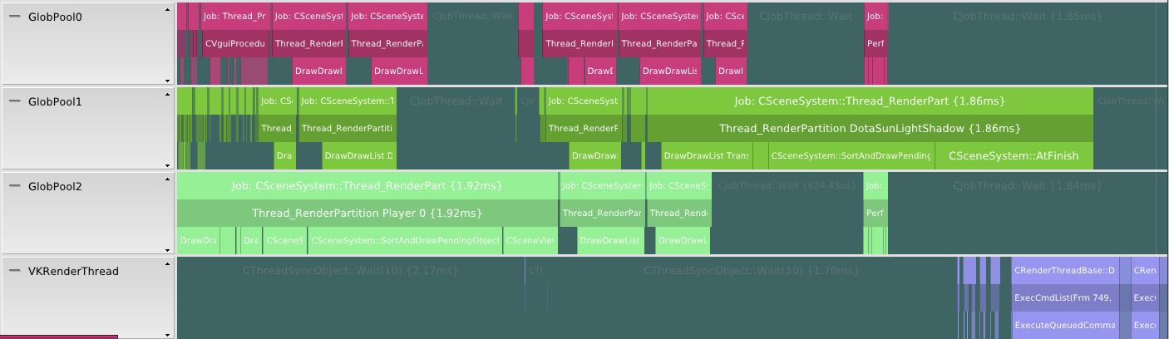
Command Buffers
Used where DX11 deferred contexts were used
Each thread builds command buffer
Single thread performs submission to queue

Slide 14
Command Buffers
Recycled within per-thread pools
Thread 0 CommandPool
Thread 1 CommandPool
Thread 2 CommandPool
Thread0
CmdBuf
CmdBuf
Thread1
CmdBuf
CmdBuf
Thread2
CmdBuf
CmdBuf
CmdBuf
Submit
Submit1
Submit2
Main
Check Fences

Slide 15
Command Buffer Performance
Submit in batches
  vkQueueSubmit has cost on Windows
  Faster to group submissions together
Minimize number of command buffers
Minimize memory referenced per command buffer
Use VK_CMD_BUFFER_OPTIMIZE_ONE_TIME_SUBMIT_BIT
  Optimize for one-time submission

Slide 16
Memory Management

Slide 17
General Strategies
Pool resources together
  Reduces memory reference count
Use per-thread pools to reduce contention
Recycle dynamic pools on frame boundaries

Slide 18
Resources
Static Resources | Dynamic Resources
Global Pools Device Only Textures/Render Targets 128MB Pools VB/IB/CBs 8MB Pools | Per-Thread Pools Host Visible (Persistently Mapped) VB/IB/CBs 8MB Pools

Slide 19
Dynamic Vertex/Index Buffers
To update:
  Grab new offset from per-thread pool
  memcpy into pool
  Bind VBs with: vkCmdBindVertexBuffers(..,buffer,offset)
  Bind IBs with: vkCmdBindIndexBuffer(..,buffer,offset,..)
Recycle pools when last GPU fence of frame retires

Slide 20
Dynamic Uniform Buffers
Differences from VB/IBs:
  UBOs are bound via descriptors
  Use dynamic UBOs to avoid vkUpdateDescriptors
  Pass UBO offset to vkCmdBindDescriptorSets
Notes:
UBOs are bound via descriptors rather than on the command buffer like VBs/IBS
We want to avoid calling vkUpdateDescriptors every time a we update a UBO
To do so, we can use dynamic UBOs which allow us to just pass a new offset to vkCmdBindDescriptorSets rather than updating the descriptor

Slide 21
Dynamic Textures
Staged in persistently mapped buffers
  Recycled per-frame
Copy with vkCmdCopyBufferToImage

Slide 22
Descriptor Sets

Slide 23
Descriptor Set - Ideal
Allocate and bake descriptor sets up front
Group sets by update frequency
Only update changed sets

Slide 24
Descriptor Set - Reality
Difficult to bake descriptors with DX11-like abstraction
Our approach
  Pre-allocate descriptor sets with fixed slots
  Only bind to used slots
  Update descriptors each draw

Slide 25
Allocating Descriptor Sets
Allocated from per-thread pools
Pre-allocate on pool creation and recycle on frame boundaries
Grab new descriptor set by just incrementing offset

Slide 26
Future optimizations
Group resources into multiple sets
Use dynamic UBOs to avoid updating UBO descriptors
Bake texture bindings higher up in abstraction
Avoid updating descriptors where possible

Slide 27
Miscellaneous

Slide 28
Swap Queue Depth
Manage yourself
Window System Interaction (WSI) extension
Create N images for swap queue depth
Fence or semaphore to manage swap queue depth

Slide 29
Image Layout Transitions
Transitions require previous and new layout
  Example: Color Attachment -> Shader Read
  Command buffers generated out-of-order
  Problem: how do we know previous layout?
Options
  Return image layouts to known states
    Good for CPU Perf, Bad for GPU Perf
  Generate command buffers to transition layouts
    Bad for CPU Perf, Good for GPU Perf
Tried both:
  Better for CPU perf
  Better for GPU perf

Slide 30
Coordinate Systems
D3D11 conventions, except:
  Y direction of clipspace is inverted
If porting from HLSL:
  Invert gl_Position.y
Reasoning: kept all spaces consistent

Slide 31
Summary
Source 2 Overview
Porting to Vulkan
  Shaders and Pipelines
  Command Buffers
  Memory Management
  Descriptor Sets

Slide 32
Questions?
dang@valvesoftware.com
Khronos BOF:
  Wed. August 12th, 5:30-7:30
  JW Marriott LA Live in the Platinum Ballroom Salon F-I

